Slide 1



Predictions of health, cognitive ability and life satisfaction from white matter microstructure
Max Korbmacher
PhD Student at Western Norway University of Applied Sciences, Bergen
Max.Korbmacher@hvl.no

Slide 2
Contents
Background
Brain data guided predictions
The best data and models in the world
Diffusion MRI metrics as a starting point
Some preliminary findings
Classifications
Predictions

Slide 3
Background: brain-data guided predictions 1/2
Predictions & classifications from brain data have generally been limited to demographics & diagnoses:
It is pretty obvious that additional meaningful predictions and classifications are possible
Predictions | Classifications
Age, diagnostic score | Sex, diagnostic group

Slide 4
Background: brain-data guided predictions 2/2
Studies using predictions of age from brain data (aka brain age) try to do all in one go
First, predict age, evaluate predictions
Second, compute difference between predictions and true age (BAG)
Third, associate the BAG with “stuff”
However, what if we predict the “stuff” directly?

Slide 5
Background: the best data and models in the world
Multimodal MRI data will improve predictions
More data will improve predictions
But when do we reach entropy?
When do our outputs become difficult to interpret? (And do we care?)
In terms of data
In terms of modelling choices (e.g. CNN vs LM)

Slide 6
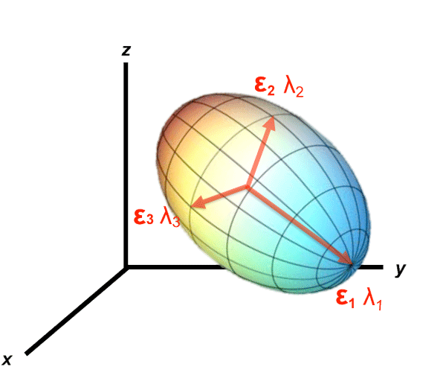
Background: diffusion MRI
Diffusion magnetic resonance imaging
Reveals valuable information about brain structure
Different approaches can be used to calculate diffusion
Most common DTI, but other biophysically more meaningful approaches available¹
e.g. assuming non-Gaussian diffusion (kurtosis) or adding priors (Bayesian approach)
1 Jensen et al., 2005, Magn. Reson. Med. 53

Slide 7
Brain-based classifictions & predictions
There is no gold standard for predictions and classifications, so I used several algorithms for each problem
Predictions | Classification
Extreme Gradient Boosting (XGB) regressor | Extreme Gradient Boosting (XGB) classifier
Random Forrest (RF) Regressor | Random Forrest (RF) Classifier
Support Vector Machine Regressor (SVR) | Support Vector Machine Classifier (SVC)
 | Logistic Regression (LR)
 | K-nearest-neighbours (KNN)
 | Gaussian Naive Bayes (GNB)

Slide 8
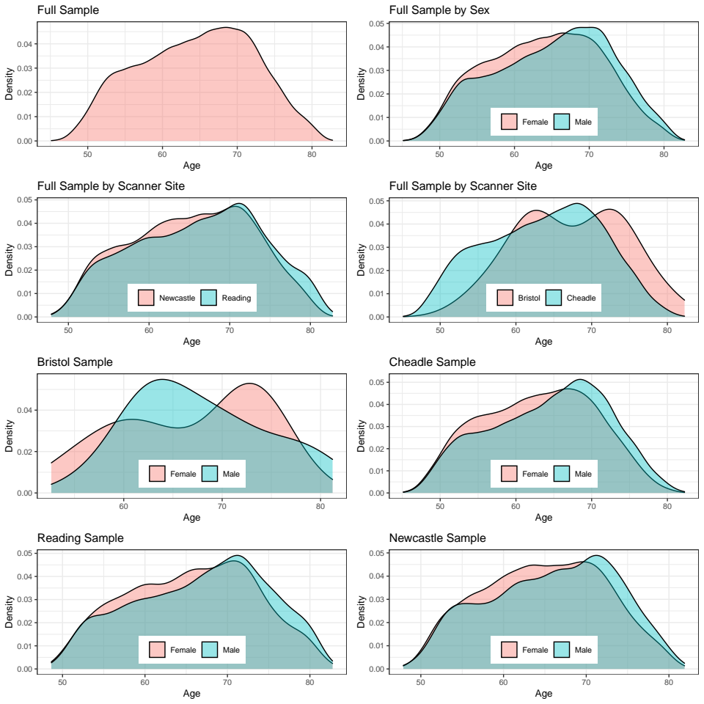
Brain-based classifictions & predictions: sample
UKB (mid-life to old age)
‘healthy’ ageing(?)
N = 35,750

Slide 9
Brain-based classifications

Slide 10
Brain-based classification challenges
Imbalanced samples are a problem
2 general remedies: undersampling or oversampling
Undersampling: reduce data and match smaller group
Oversampling copy or simulate from the bigger group
(I did both)

Slide 11
Methods: classifications
Two variables which were not imbalanced were sex and education
A little prequel on performance metrics
Precision = TP / (TP+FP)
Recall = TP / (TP + FN)
f1-score = 2(Precision*Recall) / (Precision+Recall)

Slide 12
Methods: cross-validation
For classifications, I did a train-test split training with 5-fold cross validation and then predicting in the test set

Slide 13
Brain-based classifications: sex and higher education
Two variables which were not imbalanced were sex and education

Slide 14
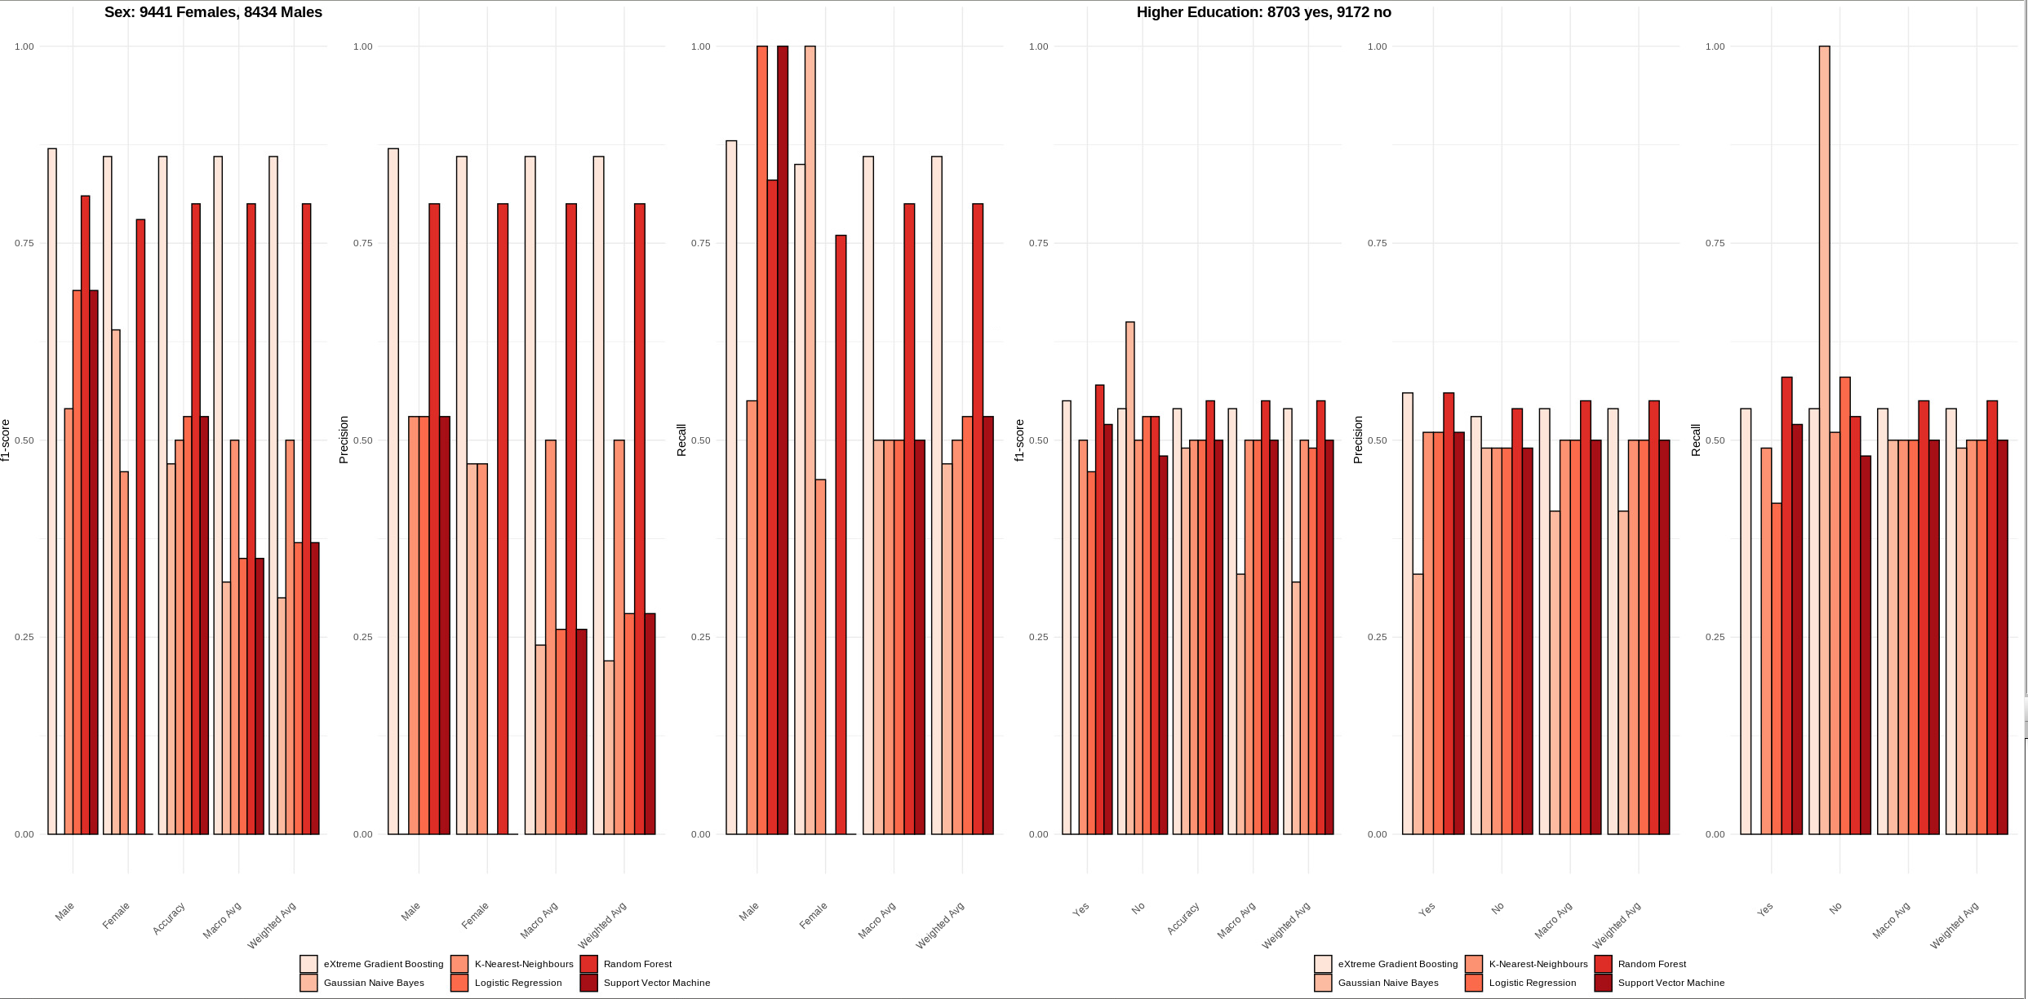
Brain-based classifications: sex and higher education
Two variables which were not imbalanced were sex and education

Slide 15
Brain-based classifications: sex and higher education
Two variables which were not imbalanced were sex and education
XG Boost
Random Forest

Slide 16
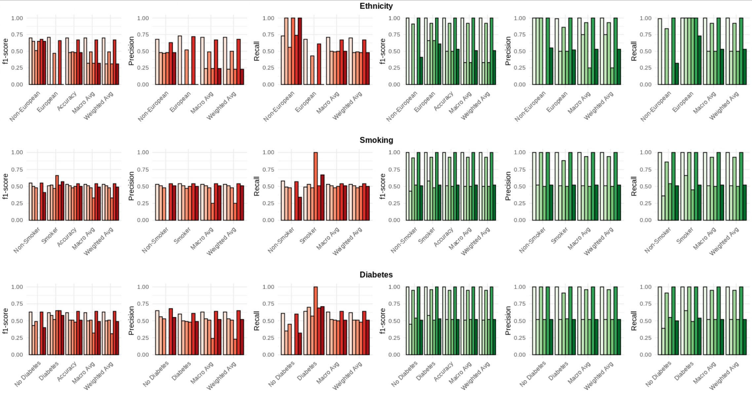
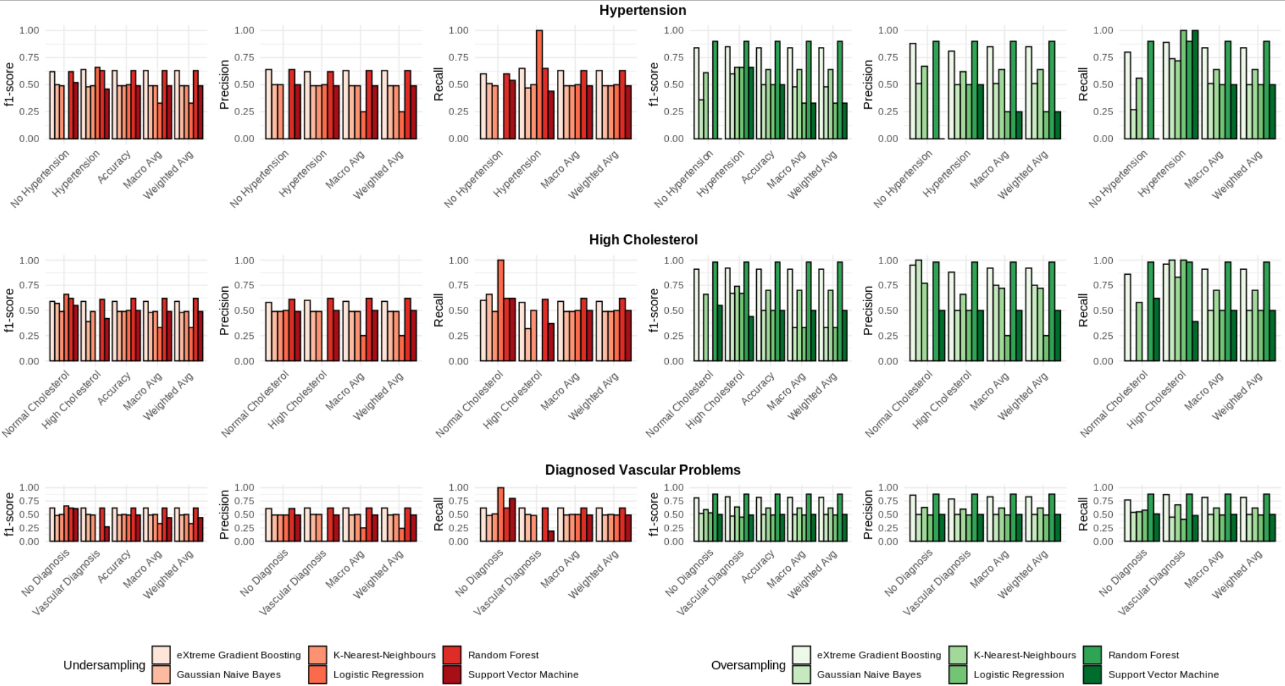
Imbalanced classifications: ethnicity, smoking, diabetes
And again XG Boost & RF

Slide 17
Imbalanced classifications: hypertension, high cholesterol, diagnosed vascular problems
And again XG Boost & RF

Slide 18
Imbalanced classifications: intermediate conclusion
Upsampling really improves classifications
Tree-based algorithms work best
Practically: diffusion data serves to classify physiological(ly impactful) features
Higher education potentially doesn’t impact physiology as much as sex, ethnicity, smoking, hypertension, high cholesterol, or vascular diagnoses

Slide 19
Brain-based predictions

Slide 20
Methods: cross-validation
For regressions, I did a 10-fold cross validation for training and 10-fold for prediction
…
potential overkill on N ~ 35,700?

Slide 21
Methods: cross-validation
Predictions | Classification
Extreme Gradient Boosting (XGB) regressor | Extreme Gradient Boosting (XGB) classifier
Random Forrest (RF) Regressor | Random Forrest (RF) Classifier
Support Vector Machine Regressor (SVR) | Support Vector Machine Classifier (SVC)
 | Logistic Regression (LR)
 | K-nearest-neighbours (KNN)
 | Gaussian Naive Bayes (GNB)

Slide 22
Brain-based predictions
Predicting principal components of:
Health
BMI, WHR, pulse pressure, birth weight
Cognitive Abilities
Prospective memory, fluid intel, digit sub, matrix puzzles solved & viewed, digits remembered
Life Satisfaction
Job, finance, health, family, friendship satisfactions and overall health (self-)rating

Slide 23
Brain-based predictions
Predicting principal components of:
Health
R² = 30.1%, MAE = 0.81, r = 0.555 (XGB ~ RF)
Cognitive Abilities
R² = 10.0%, MAE = 1.05, r = 0.316 (RF)
Life Satisfaction
R² = 0.5%, MAE = 1.35, r = -0.003 (RF)

Slide 24
Brain-based predictions: zooming into single scores
Predicting single scores of health
BMI
R² = 19.3% (0.11%), MAE = 2.938 (0.018), r = 0.457 (XGB ~ RF)
WHR
R² = 30.2% (1.1%), MAE = 0.058 (0.001), r = 0.560 (XGB ~ RF)
Pulse pressure
R² = 15.9% (0.6%), MAE = 10.39 (0.129), r = 0.400 (XGB)
Birth weight
R² = 4.5% (0.9%), MAE = 0.451, r = 0.213 (RF)

Slide 25
Brain-based predictions: zooming into single scores
Predicting single scores of cognition (waiting for results)
Prospective memory
R² = …
Fluid intel
R² = 3.2% (0.8%), MAE = 1.619 (0.022), r = 0.182 (RF)
Digit substitution
R² = 13.9% (1.4%), MAE = 3.847 (0.053), r = 0.372 (RF)
Matrix puzzles solved
R² = 5.4% (1.1%), MAE = 1.648 (0.011), r = 0.238 (RF)
Matrix puzzles viewed
R² < 0, no proper fit
Digits remembered
R² < 0, no proper fit

Slide 26
Brain-based predictions: zooming into single scores
Predicting single scores of life satisfaction
Job satisfaction
R² = 0.9% (1%), MAE = 0.689 (0.013) (RF)
Finance satisfaction
R² = ...
Health satisfaction
R² < 0
Family satisfaction
R² < 0
Friendship satisfaction
R² = ...
Overall health (self-)rating
R² = 2.1% (0.6%), MAE = 0.423 (0.006) (RF) >> preliminary!

Slide 27
Conclusion?
White matter microstructure can be used to classify various phenotypes
It also serves to give a general idea of health and cognitive abilities
However, predictions of single health scores are most informative

Slide 28


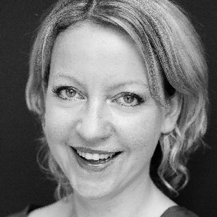






Ivan I. Maximov
Lars T. Westlye
Eli N. Eikefjord
Arvid Lundervold
Thank you!
Dennis van der Meer
Ann Marie de Lange
Dani Beck
Ole A. Andreassen
Tiril Gurholt

